Slide 1

2D SUDOKU ASSOCIATED BIJECTIONS FOR IMAGE SCRAMBLING
BATCH MEMBERS
AASHIKA PREMKUMAR 119004002
MONISHAA P 119004100
VENNILA K 119004221
VISHALI S 119004228
MENTOR
DR. V. PADMAPRIYA
BECCEC608/MINI PROJECT - 1

Slide 2
INTRODUCTION
Sudoku - 2D number puzzle
Alternate method of matrix representation
Sudoku associated image scrambler
2D associated bijection for image scrambling
No bandwidth expansion

Slide 3
MOTIVATION
Development of Digital Communication
Increase in amount of digital data transmission
Secured storage and transmission
Protection from unauthorized usage

Slide 4
OBJECTIVE
To implement Sudoku associated two dimensional
image scrambler

Slide 5
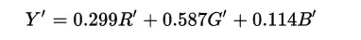
IMAGE SELECTION
Type: RBG image
3 shades (R-G-B) - 8 bit each
24 bit colour image
Pixel range : 0-255
Image size : 360 x 360

Slide 6
SUDOKU GENERATOR
WorkMat( )
CheckRow( ), CheckColumn( ), CheckBlock( ) - To avoid repetition of values
To assign digit values
PlotMatrix( )
Handles font style, size, colour, alignment and display

Slide 7
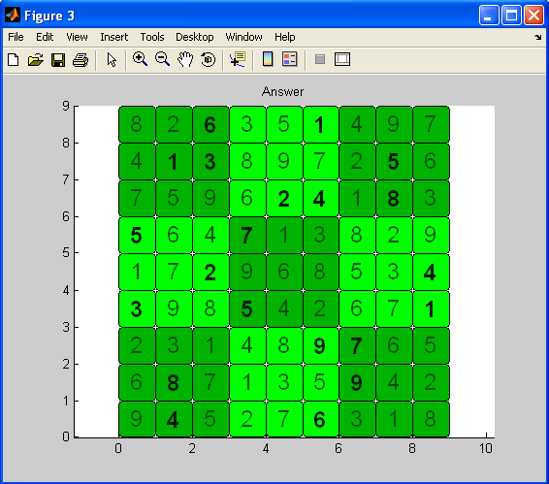
OUTPUT OF SUDUKO GENERATOR

Slide 8
SUDOKO METHOD
This method uses pairs of sudoku puzzles to map original and scrambled images
There is a 1 – 1 relationship between the digits of the puzzles
It scrambles the image by taking a pixel in the original image, locating the digit entry in one sudoku puzzle and moving it to the corresponding digit in the other puzzle

Slide 9
FLOW GRAPH
READ IMAGE
PAIR SELECTION
PAIR PREPARATION
DESCRAMBLING
BITWISE SCRAMBLING
BLOCK SCRAMBLING

Slide 10
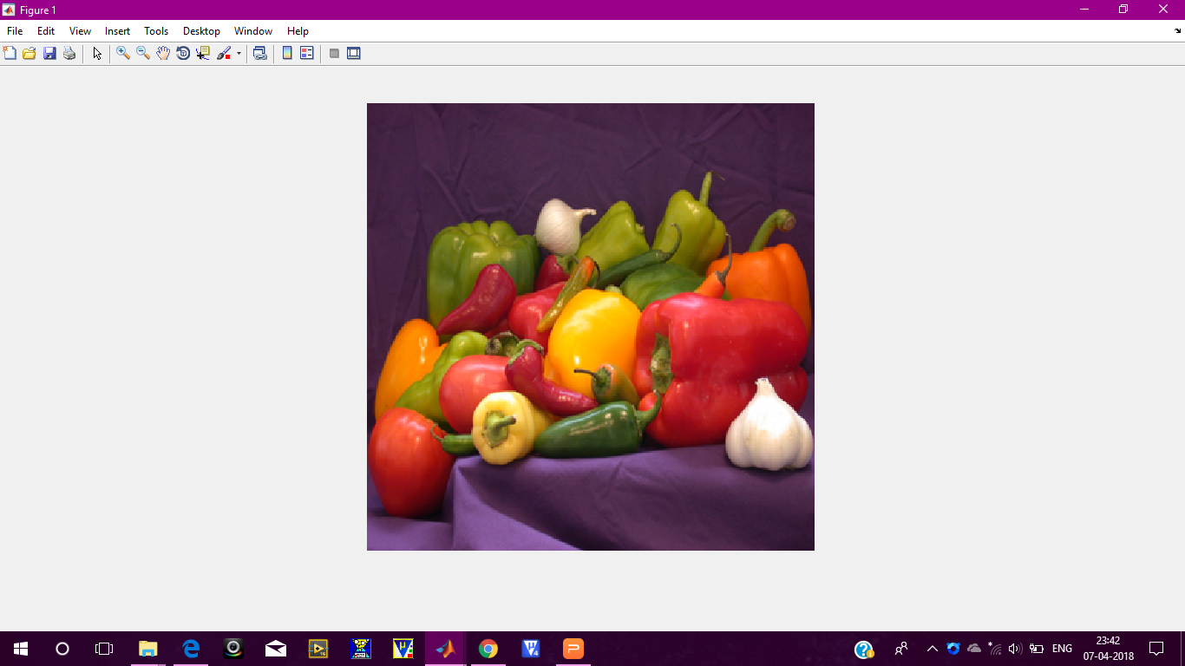
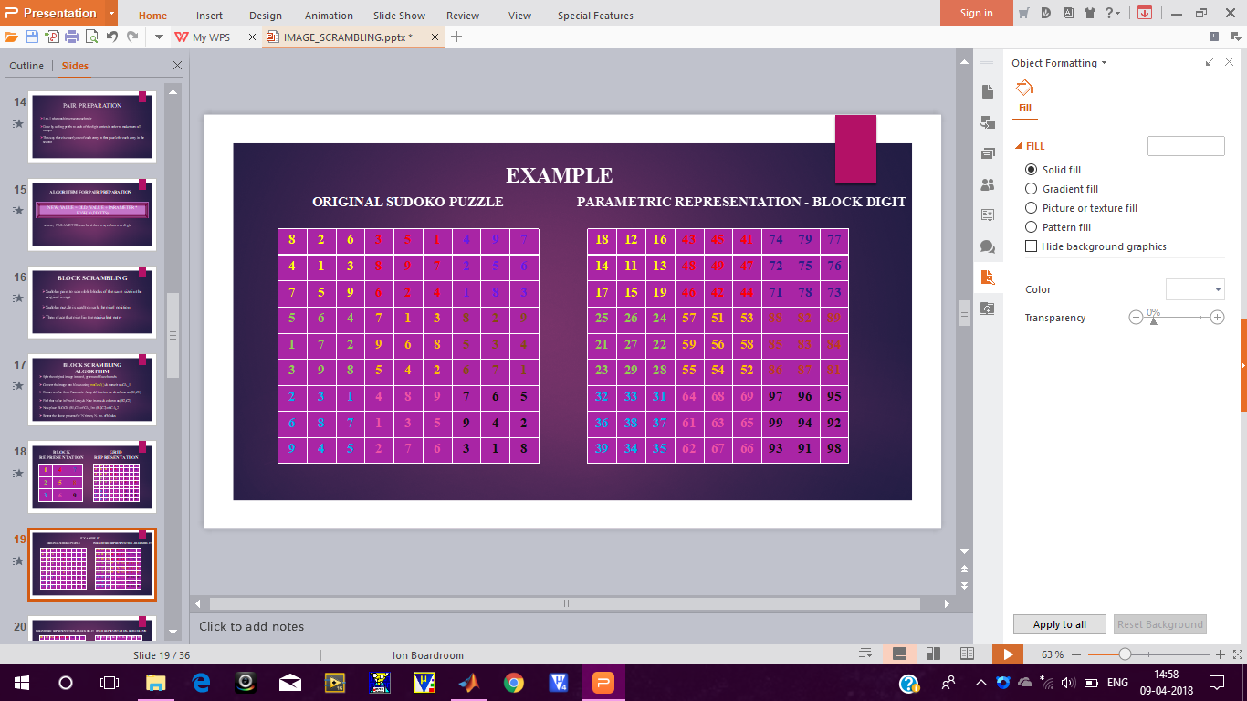
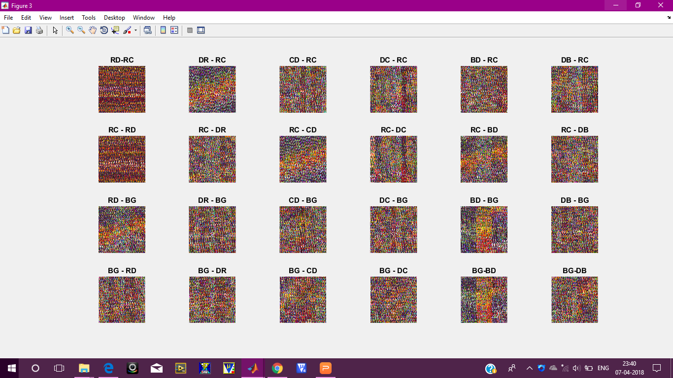
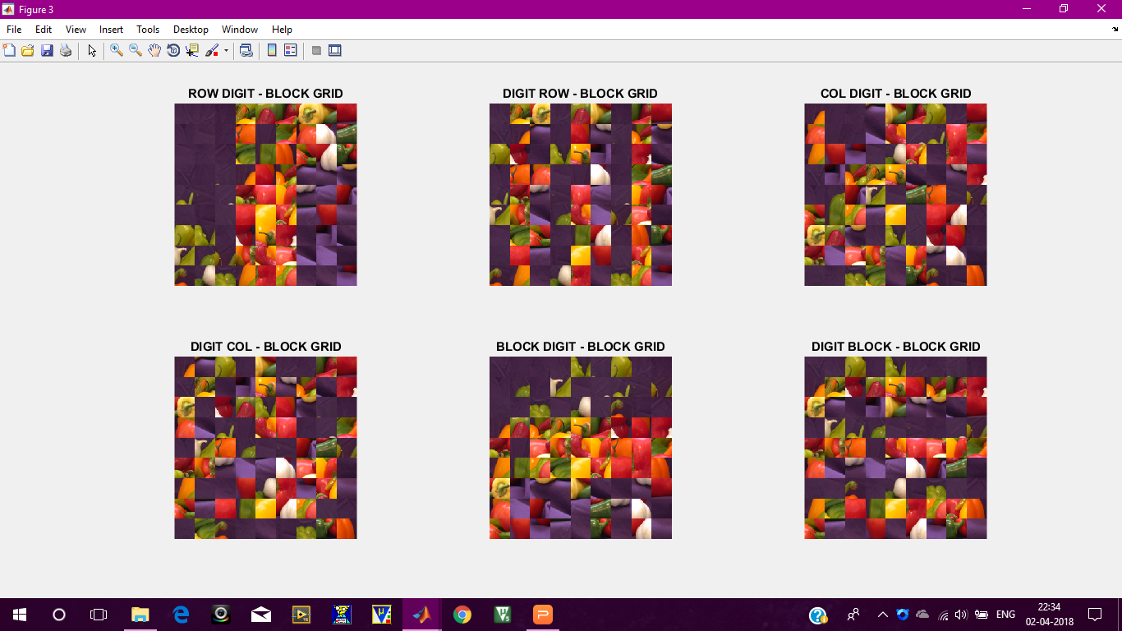
PICTORIAL REPRESENTATION

Slide 11
SUDOKU PAIR SELECTION
Pairs can be of any size and numbers
Different pairs can improve the security of the method

Slide 12
COLUMN DIGIT
BLOCK DIGIT
ROW DIGIT
DIGIT BLOCK
PARAMETRIC REPRESENTATION
DIGIT ROW
DIGIT COLUMN

Slide 13
ROW COLUMN
BLOCK GRID
FIXED REPRESENTATION

Slide 14
FORWARD MAPPING
REVERSE MAPPING
MAPPING METHODOLOGY

Slide 15
PAIR PREPARATION
1-to-1 relationship between each pair
Done by adding prefix to each of the digit entries in order to make them all unique
This way there is exactly one of each entry in first puzzle for each entry in the second

Slide 16
ALGORITHM FOR PAIR PREPARATION
NEW_VALUE = OLD_VALUE + PARAMETER * POW(10,DIGITS)
where, PARAMETER can be either row, column or digit

Slide 17
BLOCK SCRAMBLING
Sudoku pairs to scramble blocks of the same size in the original image
Sudoku puzzle is used to mark the pixel position
Then place that pixel in the equivalent entry

Slide 18
BLOCK SCRAMBLING ALGORITHM
Split the original image into red, green and blue channels
Convert the image into blocks using mat2cell( ) & name it as CA_1
Extract a value from Parametric Array & Note its row & column as (R1,C1)
Find that value in Fixed Array & Note its row & column as (R2,C2)
Now place BLOCK (R1,C1) of CA_1 to (R2,C2) of CA_2
Repeat the above process for 'N' times, N - no. of blocks

Slide 19
BLOCK REPRESENTATION
GRID REPRESENTATION
1 | 4 | 7
2 | 5 | 8
3 | 6 | 9
1 | 4 | 7 | 1 | 4 | 7 | 1 | 4 | 7
2 | 5 | 8 | 2 | 5 | 8 | 2 | 5 | 8
3 | 6 | 9 | 3 | 6 | 9 | 3 | 6 | 9
1 | 4 | 7 | 1 | 4 | 7 | 1 | 4 | 7
2 | 5 | 8 | 2 | 5 | 8 | 2 | 5 | 8
3 | 6 | 9 | 3 | 6 | 9 | 3 | 6 | 9
1 | 4 | 7 | 1 | 4 | 7 | 1 | 4 | 7
2 | 5 | 8 | 2 | 5 | 8 | 2 | 5 | 8
3 | 6 | 9 | 3 | 6 | 9 | 3 | 6 | 9

Slide 20
EXAMPLE
ORIGINAL SUDOKO PUZZLE
PARAMETRIC REPRESENTATION - BLOCK DIGIT
8 | 2 | 6 | 3 | 5 | 1 | 4 | 9 | 7
4 | 1 | 3 | 8 | 9 | 7 | 2 | 5 | 6
7 | 5 | 9 | 6 | 2 | 4 | 1 | 8 | 3
5 | 6 | 4 | 7 | 1 | 3 | 8 | 2 | 9
1 | 7 | 2 | 9 | 6 | 8 | 5 | 3 | 4
3 | 9 | 8 | 5 | 4 | 2 | 6 | 7 | 1
2 | 3 | 1 | 4 | 8 | 9 | 7 | 6 | 5
6 | 8 | 7 | 1 | 3 | 5 | 9 | 4 | 2
9 | 4 | 5 | 2 | 7 | 6 | 3 | 1 | 8
18 | 12 | 16 | 43 | 45 | 41 | 74 | 79 | 77
14 | 11 | 13 | 48 | 49 | 47 | 72 | 75 | 76
17 | 15 | 19 | 46 | 42 | 44 | 71 | 78 | 73
25 | 26 | 24 | 57 | 51 | 53 | 88 | 82 | 89
21 | 27 | 22 | 59 | 56 | 58 | 85 | 83 | 84
23 | 29 | 28 | 55 | 54 | 52 | 86 | 87 | 81
32 | 33 | 31 | 64 | 68 | 69 | 97 | 96 | 95
36 | 38 | 37 | 61 | 63 | 65 | 99 | 94 | 92
39 | 34 | 35 | 62 | 67 | 66 | 93 | 91 | 98

Slide 21
PARAMETRIC REPRESENTATION - BLOCK DIGIT
FIXED REPRESENTATION - ROW COLUMN
18 | 12 | 16 | 43 | 45 | 41 | 74 | 79 | 77
14 | 11 | 13 | 48 | 49 | 47 | 72 | 75 | 76
17 | 15 | 19 | 46 | 42 | 44 | 71 | 78 | 73
25 | 26 | 24 | 57 | 51 | 53 | 88 | 82 | 89
21 | 27 | 22 | 59 | 56 | 58 | 85 | 83 | 84
23 | 29 | 28 | 55 | 54 | 52 | 86 | 87 | 81
32 | 33 | 31 | 64 | 68 | 69 | 97 | 96 | 95
36 | 38 | 37 | 61 | 63 | 65 | 99 | 94 | 92
39 | 34 | 35 | 62 | 67 | 66 | 93 | 91 | 98
11 | 12 | 13 | 14 | 15 | 16 | 17 | 18 | 19
21 | 22 | 23 | 24 | 25 | 26 | 27 | 28 | 29
31 | 32 | 33 | 34 | 35 | 36 | 37 | 38 | 39
41 | 42 | 43 | 44 | 45 | 46 | 47 | 48 | 49
51 | 52 | 53 | 54 | 55 | 56 | 57 | 58 | 59
61 | 62 | 63 | 64 | 65 | 66 | 67 | 68 | 69
71 | 72 | 73 | 74 | 75 | 76 | 77 | 78 | 79
81 | 82 | 83 | 84 | 85 | 86 | 87 | 88 | 89
91 | 92 | 93 | 94 | 95 | 96 | 97 | 98 | 99

Slide 22
1 | 2 | 3 | 4 | 5 | 6 | 7 | 8 | 9
10 | 11 | 12 | 13 | 14 | 15 | 16 | 17 | 18
19 | 20 | 21 | 22 | 23 | 24 | 25 | 26 | 27
28 | 29 | 30 | 31 | 32 | 33 | 34 | 35 | 36
37 | 38 | 39 | 40 | 41 | 42 | 43 | 44 | 45
46 | 47 | 48 | 49 | 50 | 51 | 52 | 53 | 54
55 | 56 | 57 | 58 | 59 | 60 | 61 | 62 | 63
64 | 65 | 66 | 67 | 68 | 69 | 70 | 71 | 72
73 | 74 | 75 | 76 | 77 | 78 | 79 | 80 | 81
11 | 2 | 12 | 10 | 20 | 3 | 19 | 1 | 21
37 | 39 | 46 | 30 | 28 | 29 | 38 | 48 | 47
57 | 55 | 56 | 74 | 75 | 64 | 66 | 65 | 73
6 | 23 | 4 | 24 | 5 | 22 | 15 | 13 | 14
32 | 61 | 33 | 50 | 49 | 41 | 31 | 42 | 40
67 | 76 | 68 | 58 | 69 | 78 | 77 | 59 | 60
25 | 16 | 27 | 7 | 17 | 18 | 9 | 26 | 8
54 | 35 | 44 | 45 | 43 | 52 | 53 | 34 | 36
80 | 72 | 79 | 71 | 63 | 62 | 61 | 81 | 70
ORIGINAL
IMAGE
SCRAMBLED
IMAGE
18 | 12 | 16 | 43 | 45 | 41 | 74 | 79 | 77
14 | 11 | 13 | 48 | 49 | 47 | 72 | 75 | 76
17 | 15 | 19 | 46 | 42 | 44 | 71 | 78 | 73
25 | 26 | 24 | 57 | 51 | 53 | 88 | 82 | 89
21 | 27 | 22 | 59 | 56 | 58 | 85 | 83 | 84
23 | 29 | 28 | 55 | 54 | 52 | 86 | 87 | 81
32 | 33 | 31 | 64 | 68 | 69 | 97 | 96 | 95
36 | 38 | 37 | 61 | 63 | 65 | 99 | 94 | 92
39 | 34 | 35 | 62 | 67 | 66 | 93 | 91 | 98
11 | 12 | 13 | 14 | 15 | 16 | 17 | 18 | 19
21 | 22 | 23 | 24 | 25 | 26 | 27 | 28 | 29
31 | 32 | 33 | 34 | 35 | 36 | 37 | 38 | 39
41 | 42 | 43 | 44 | 45 | 46 | 47 | 48 | 49
51 | 52 | 53 | 54 | 55 | 56 | 57 | 58 | 59
61 | 62 | 63 | 64 | 65 | 66 | 67 | 68 | 69
71 | 72 | 73 | 74 | 75 | 76 | 77 | 78 | 79
81 | 82 | 83 | 84 | 85 | 86 | 87 | 88 | 89
91 | 92 | 93 | 94 | 95 | 96 | 97 | 98 | 99
BLOCK
DIGIT
ROW
COLUMN

Slide 23
BLOCK SCRAMBLING ALGORITHM
This operations has to be done for all 3 colors.
After scrambling, now we have to join all 3 channels (Red, Green & Blue)
For performing this operation, use cat( ) function
Display the image using imshow( ) function

Slide 24
ORIGINAL IMAGE

Slide 25
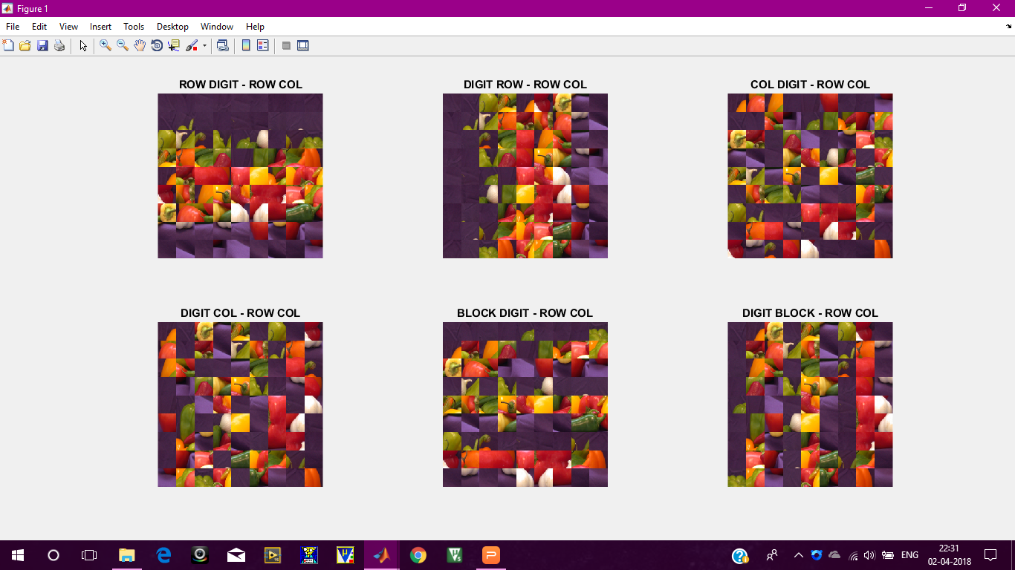
FORWARD
MAPPING

Slide 26
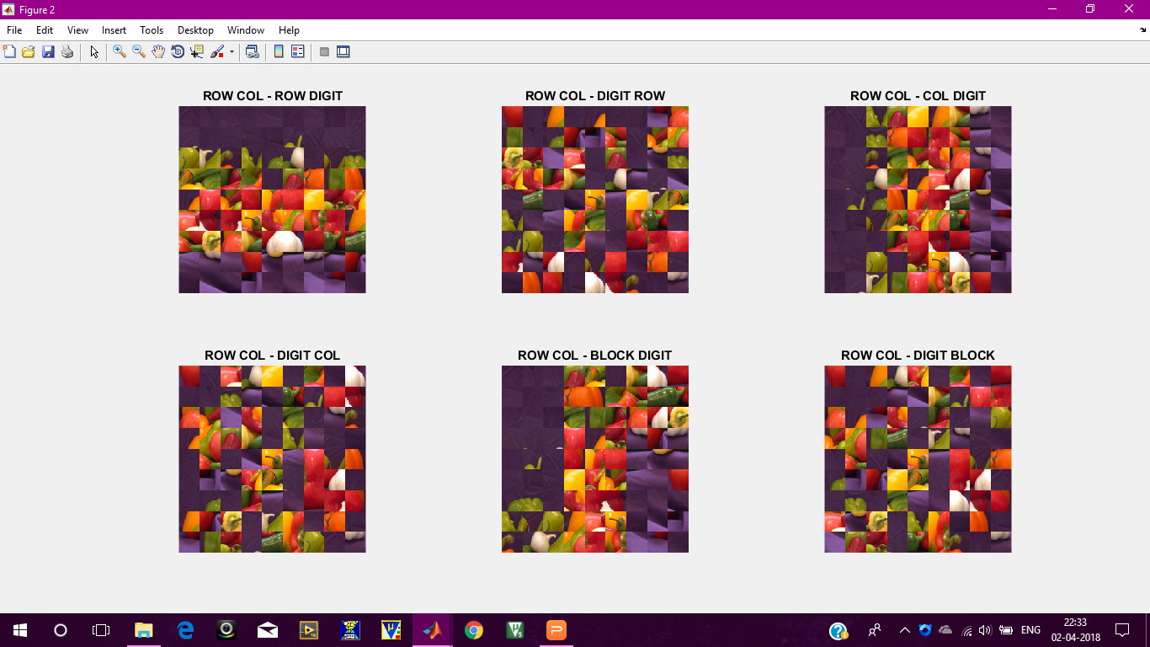
REVERSE
MAPPING

Slide 27
FORWARD
MAPPING

Slide 28
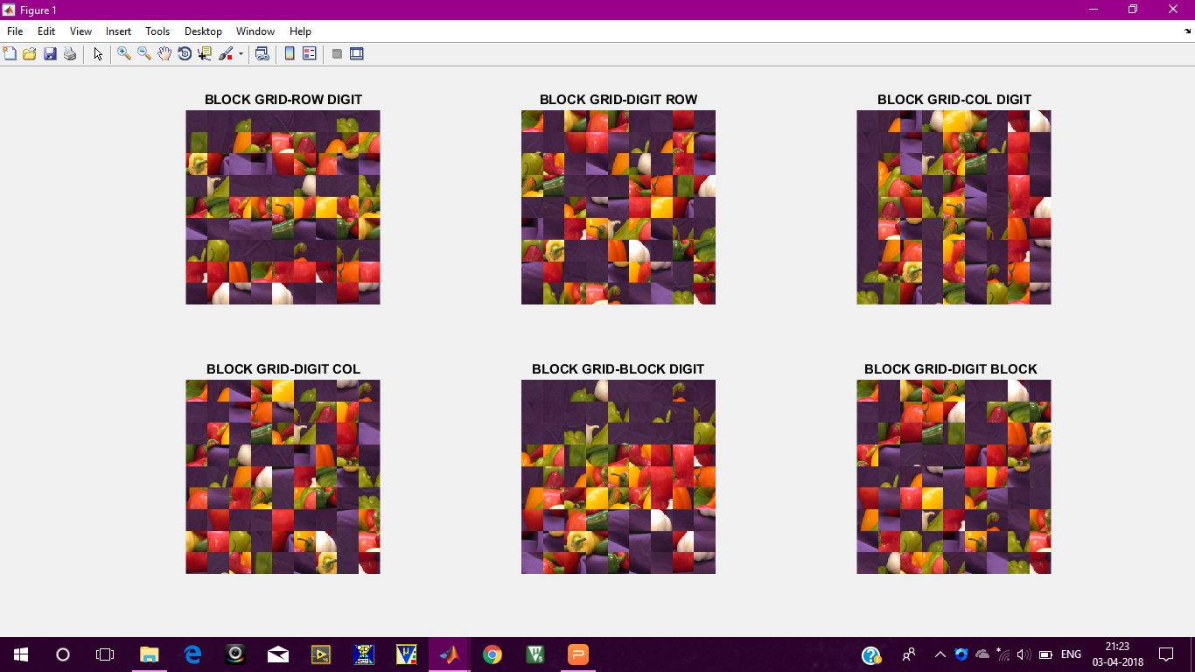
REVERSE
MAPPING

Slide 29
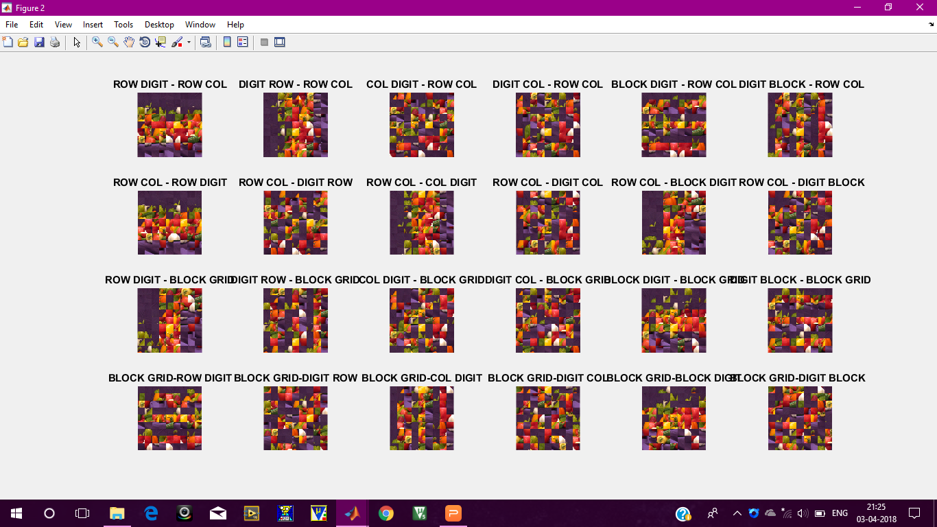
TOTAL
24
MAPPING

Slide 30
BITWISE SCRAMBLING
Pixel values of the image are represented by its corresponding binary values
Every single bit of all pixel will form a bit plane

Slide 31
BITWISE ALGORITHM
Flatten the scrambled image into a 1D array by connecting each row together - use horzcat( ) function
Array length will be P, where P - no of pixels
Create a column having its binary value - use de2bi( ) function
This gives a 2D array of size 8 X P
Reshape it accordingly - use reshape( ) function

Slide 32
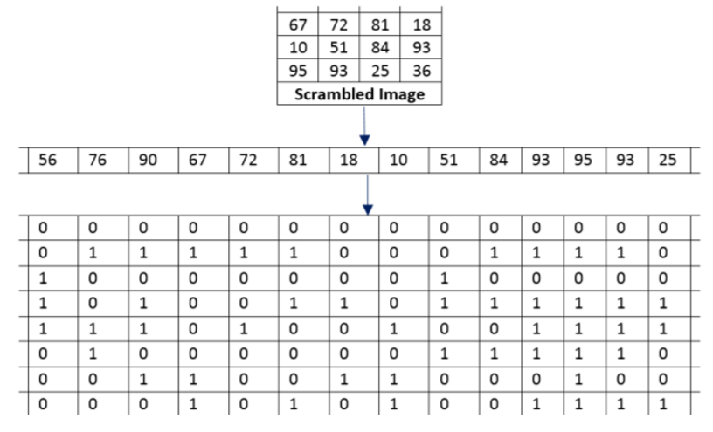
BIT SCRAMBLING MATRIX GENERATION

Slide 33
BITWISE ALGORITHM
Perform the same puzzle pair scrambling to this 2D array
Reshape it into 8 X P - use reshape( ) function
Extract each column and convert this binary values to decimal - use num2str( ) & bin2dec( ) function
This decimal corresponds to new pixel values

Slide 34
BITWISE ALGORITHM
This must be done for all 3 colors (Red, Green and Blue)
Later join all 3 colors using cat( ) function
Display the image using imshow( ) function
This method won't show any information about the image

Slide 35
BITWISE OUTPUT

Slide 36
DESCRAMBLING
To descramble the image to its original form, one must simply exchange roles of prepared Sudoku puzzles and reverse the scrambling steps .This will successfully restore the image.

Slide 37
CORRELATION
Represents the mutual relationship between the original and scrambled image.
COLOR | RED | GREEN | BLUE
ROW DIGIT - ROW COLUMN FORWARD MAPPING | 0.0495 | 0.0246 | 0.0283

Slide 38
WHAT IS A HISTOGRAM ???
An image histogram acts as a graphical representation of the tonal distribution in a digital image.
It plots the number of pixels for each intensity value.
This plots helps us judge the intensity variation at one glance.

Slide 39
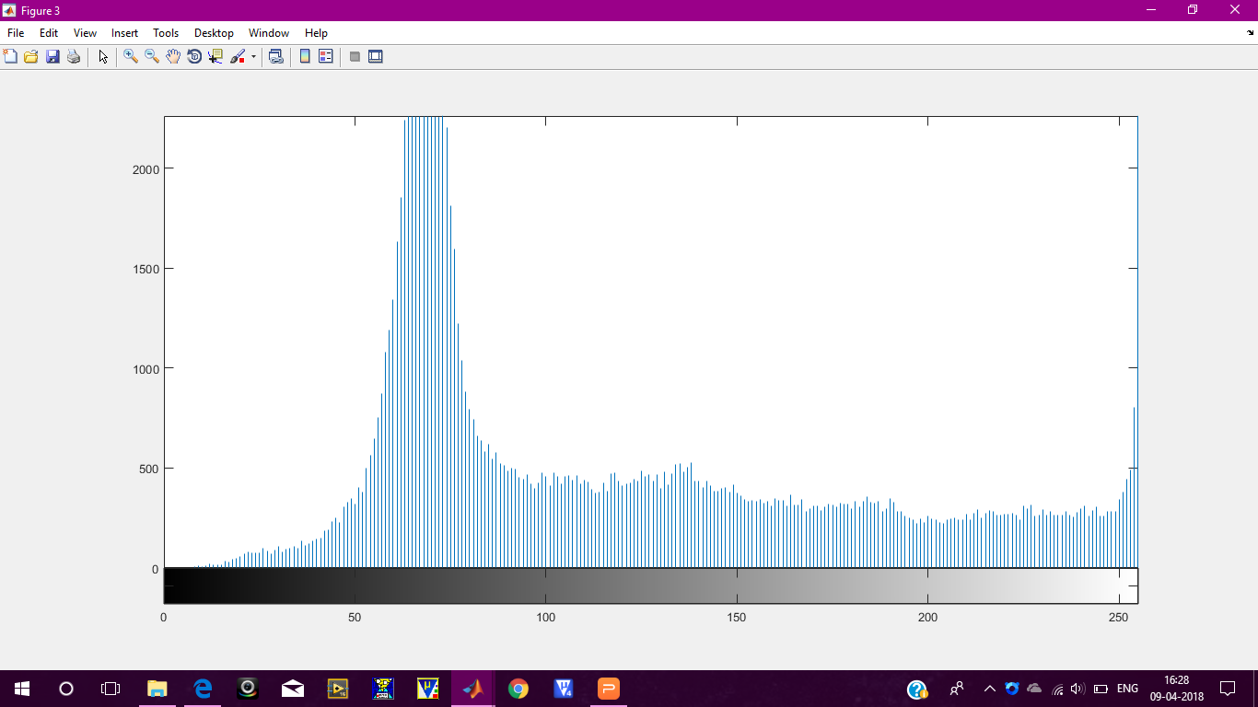
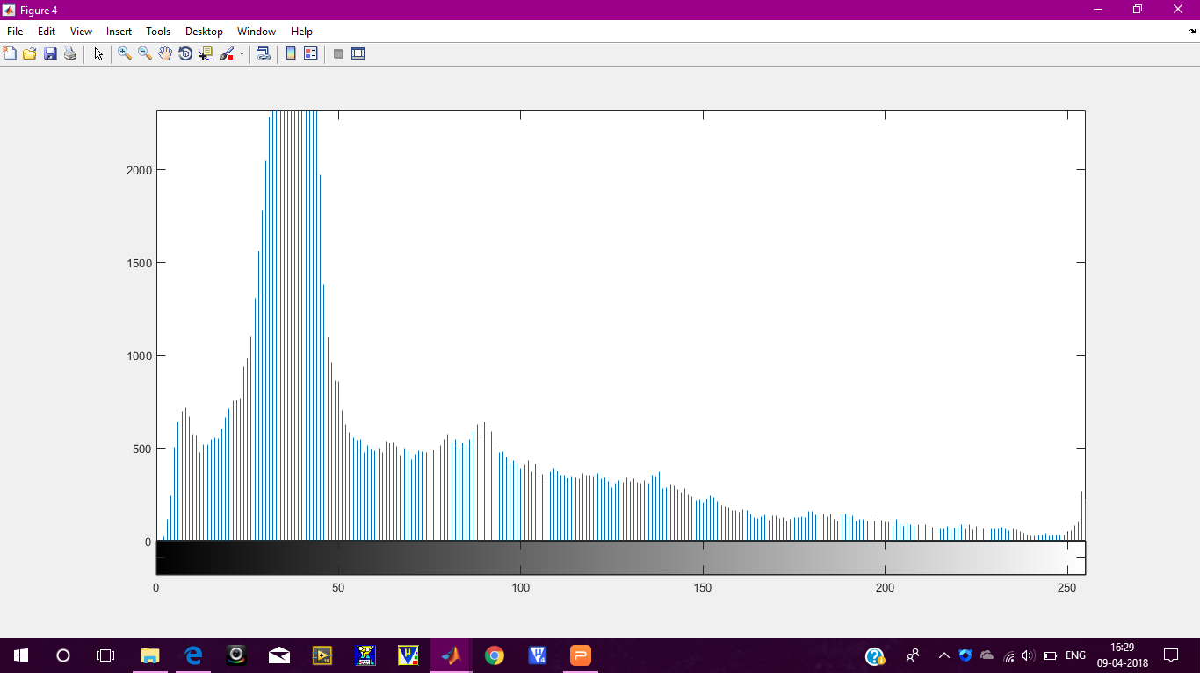
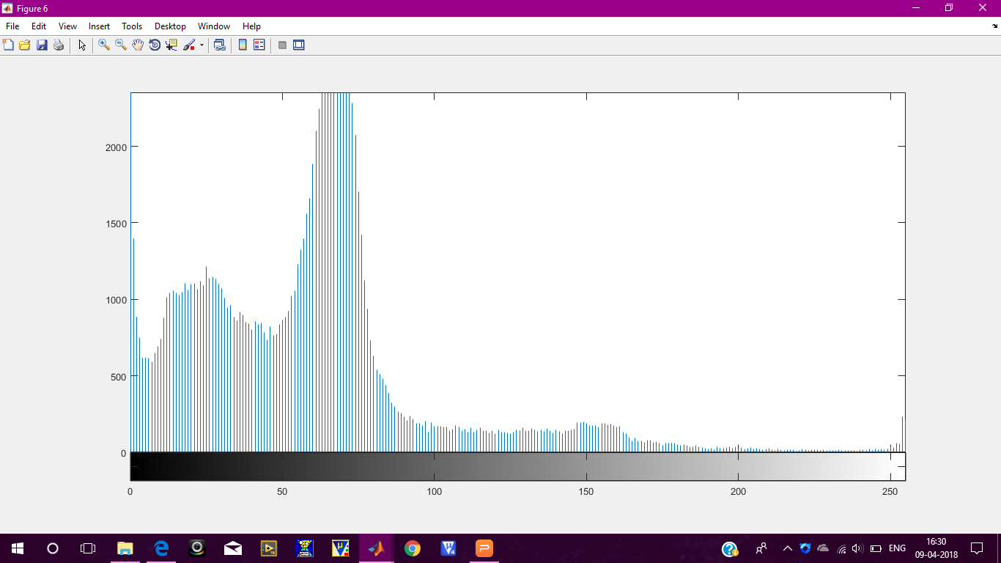
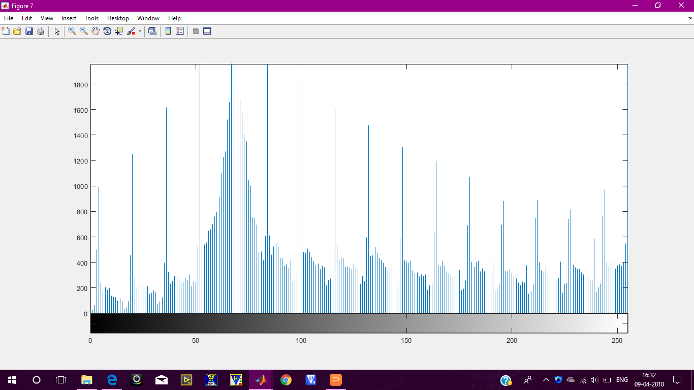
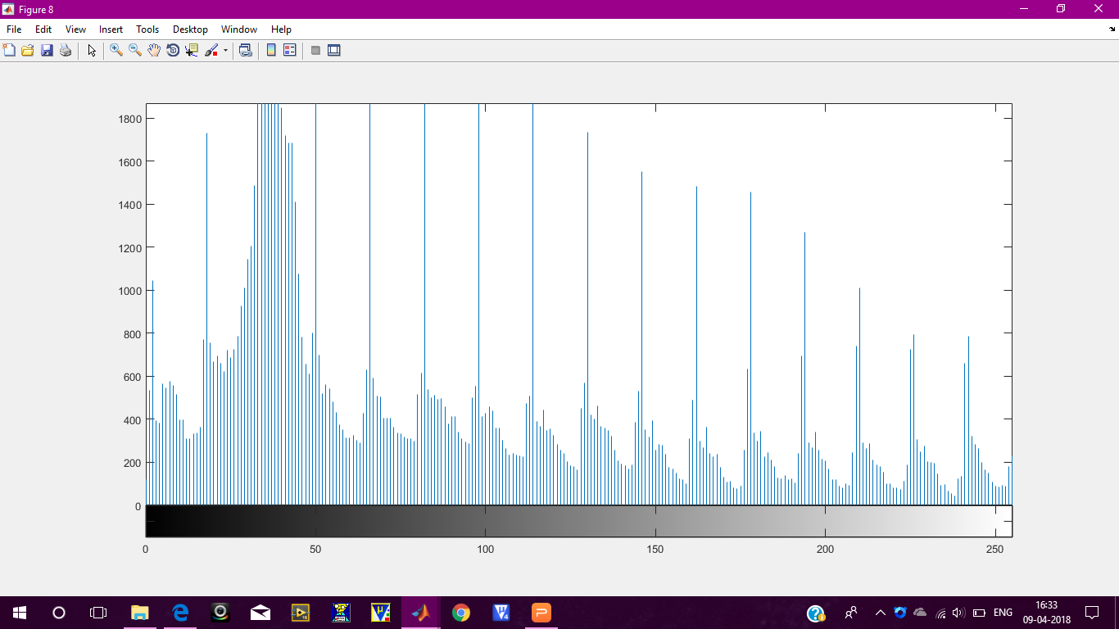
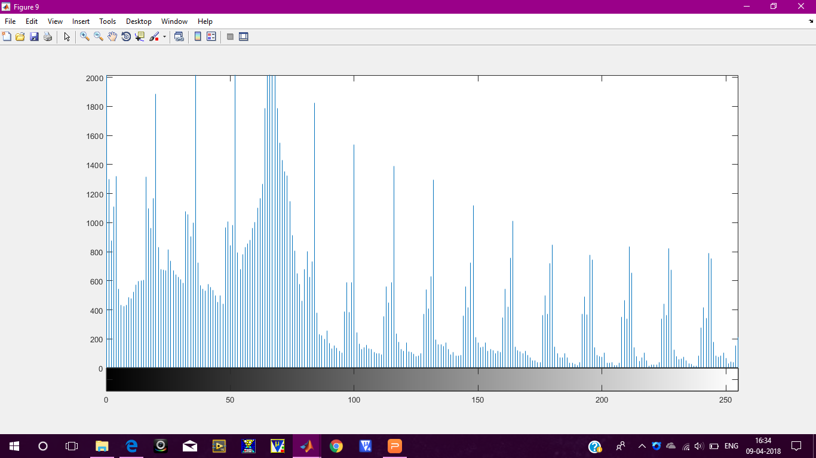
HISTOGRAM OUTPUT
RED
GREEN
BLUE
ORIGINAL
IMAGE
SCRAMB-LED
IMAGE

Slide 40
WHAT IS IMAGE ENTROPY?
Image entropy is a quantity which is used to describe the amount of information
which must be coded for by a compression algorithm.
Low entropy images have very little contrast.
High entropy images have great value of contrast from one pixel to another.
For an efficient scrambling technique, there must be significant difference between
the original and scrambled image.

Slide 41
ENTROPY COMPARISION FOR BITWISE - FORWARD MAPPING METHODOLOGY
MAPPING | ROW COLUMN
ROW DIGIT | 7.3873
DIGIT ROW | 7.6278
COLUMN DIGIT | 7.6254
DIGIT COLUMN | 7.6285
BLOCK DIGIT | 7.6294
DIGIT BLOCK | 7.6280

Slide 42
COMPARISON OF VARIOUS IMAGE SCRAMBLING TECHNIQUES
PARAMETER | RUBIKS CUBE | ARNOLD’S CAT | SUDOKU PUZZLE
BASIC UNIT | PIXEL/BLOCK | PIXEL | BLOCK
SCRAMBLING TIMES | ANY NO OF TIMES | FIXED | ANY NO OF TIMES
AREA | ANY TYPE | SQUARE | SQUARE
REASSEMBLY | BY REVERSING | BY RE-SCRAMBLING | BY REVERSING

Slide 43
APPLICATIONS OF IMAGE SCRAMBLING
Scrambled images are used to improve image security.
This technique is most widely used for military information as this avoids decoding of sensitive information.
It is also used to encrypt medical images to protect patients’ privacy.
Image scrambling is necessary for secure end to end data transmission.

Slide 44
REFERENCE PAPERS
A Comprehensive Survey on Image Scrambling Techniques - Prarthana Madan Modak1, Dr. Vijaykumar Pawar
2D Sudoku associated bijections for image scrambling - Yue Wua, Yicong Zhoub, Sos Agaianc, Joseph P. Noonana
Image Scrambling Methods for Image Hiding: A Survey Reema Rhine #1, Nikhila T Bhuvan*2

Slide 45
THANK YOU

